Slide 1
Student LMS Team Project
For tracking and managing basic student information
By:
Lucas Baralt
Danny Ho
Stephanie Alvarenga
Sabrina Hernandez
Natasha Jadagu

Slide 2
Features and Applications
-Store and retrieve student
information such as:
Student’s name & ID
Registered courses per semester
Exam score per course
GPA calculation

Slide 3
Features and Applications contd.
-Distinct Admin & student information
accessibility
-Adding, deleting, inserting, and modifying a record
-Log in and out
-Browsing records

Slide 4
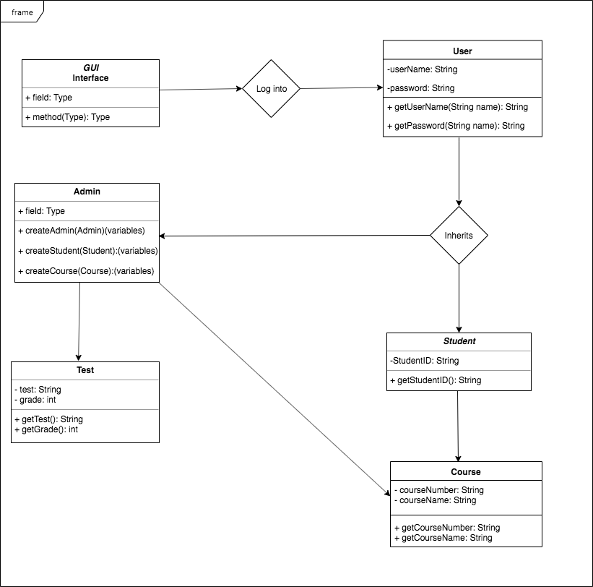
UML
DIAGRAM

Slide 5
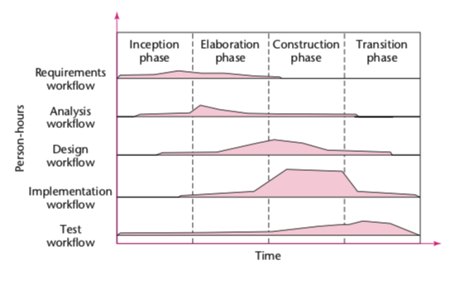
System Development Life Cycle
Iterative
and
Incremental Model

Slide 6
Iterative and Incremental Life Cycle Model
-Iterative and incremental model closely models real-world software production
-Is used to cope with the complexity of large software products.
-Iterative and incremental model underlies the unified process, which is the best solution to treat a large problem

Slide 7
Reasons to use Iterative and Incremental Life Cycle Model
-iterative and incremental model offers a further opportunity to find faults and correct them
-The robustness of the underlying architecture can be determined early in the life cycle
-can mitigate risks early

Slide 8
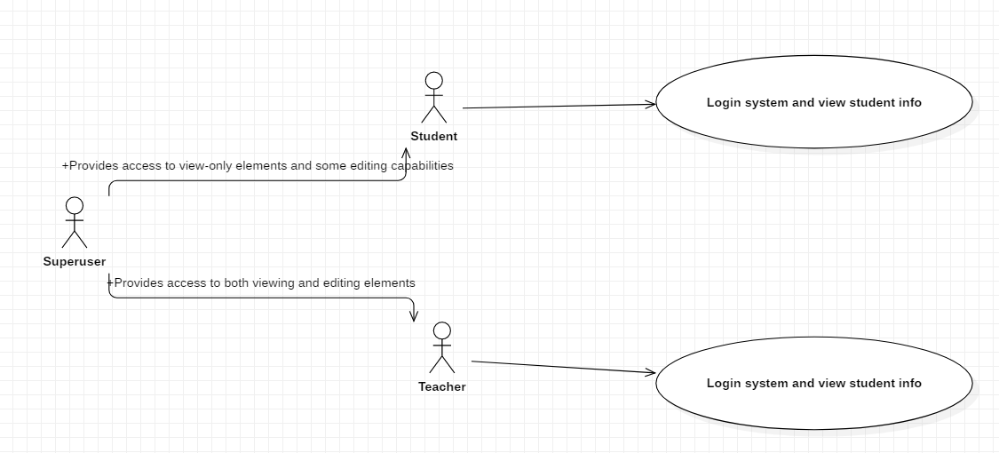
USE CASE DIAGRAM

Slide 9
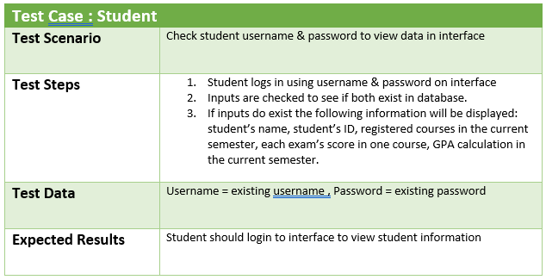
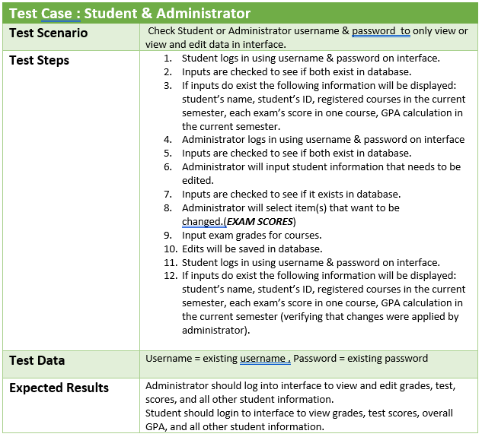
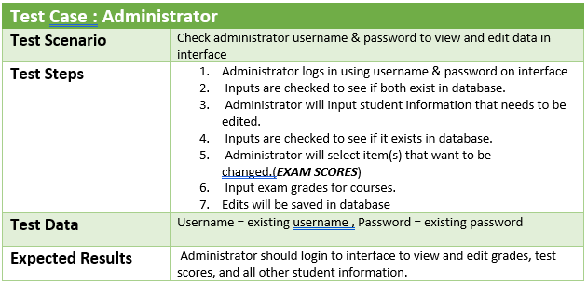
Test Cases

Slide 10
Teamwork slide
-Our team implemented the Democratic Team model to create our project.
We decided to use the Democratic Team model because we wanted each team member to be able to make modifications to the project as and when needed.
Using this model enabled each team member to see the code as an extension of oneself which enabled the team members to take the project task seriously

Slide 11
Teamwork slide (contd)
Using this model also enabled us to search for faults within our written code so as to make the project more efficient
The democratic team model also enabled us to develop group identity which made easier for us to work together as a group
Utilizing the democratic team model also allowed us to work in an egoless environment which meant that no team member would dominate the others

Slide 12
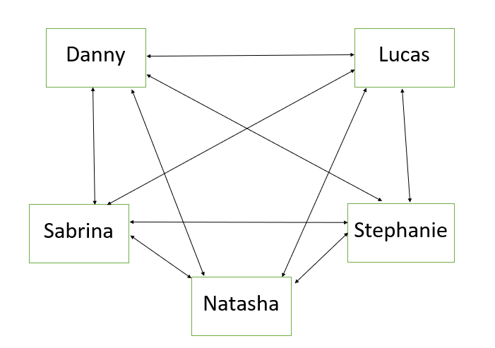
COMMUNICATION
DIAGRAM

Slide 13
SOFTWARE PROJECT MANAGEMENT PLAN
(SPMP)
https://docs.google.com/document/d/1rw69ZDvUfMyDcPjBdYoehO8kKJsr0Kd5LYhCU-WCG2U/edit?usp=sharing

